Slide 1
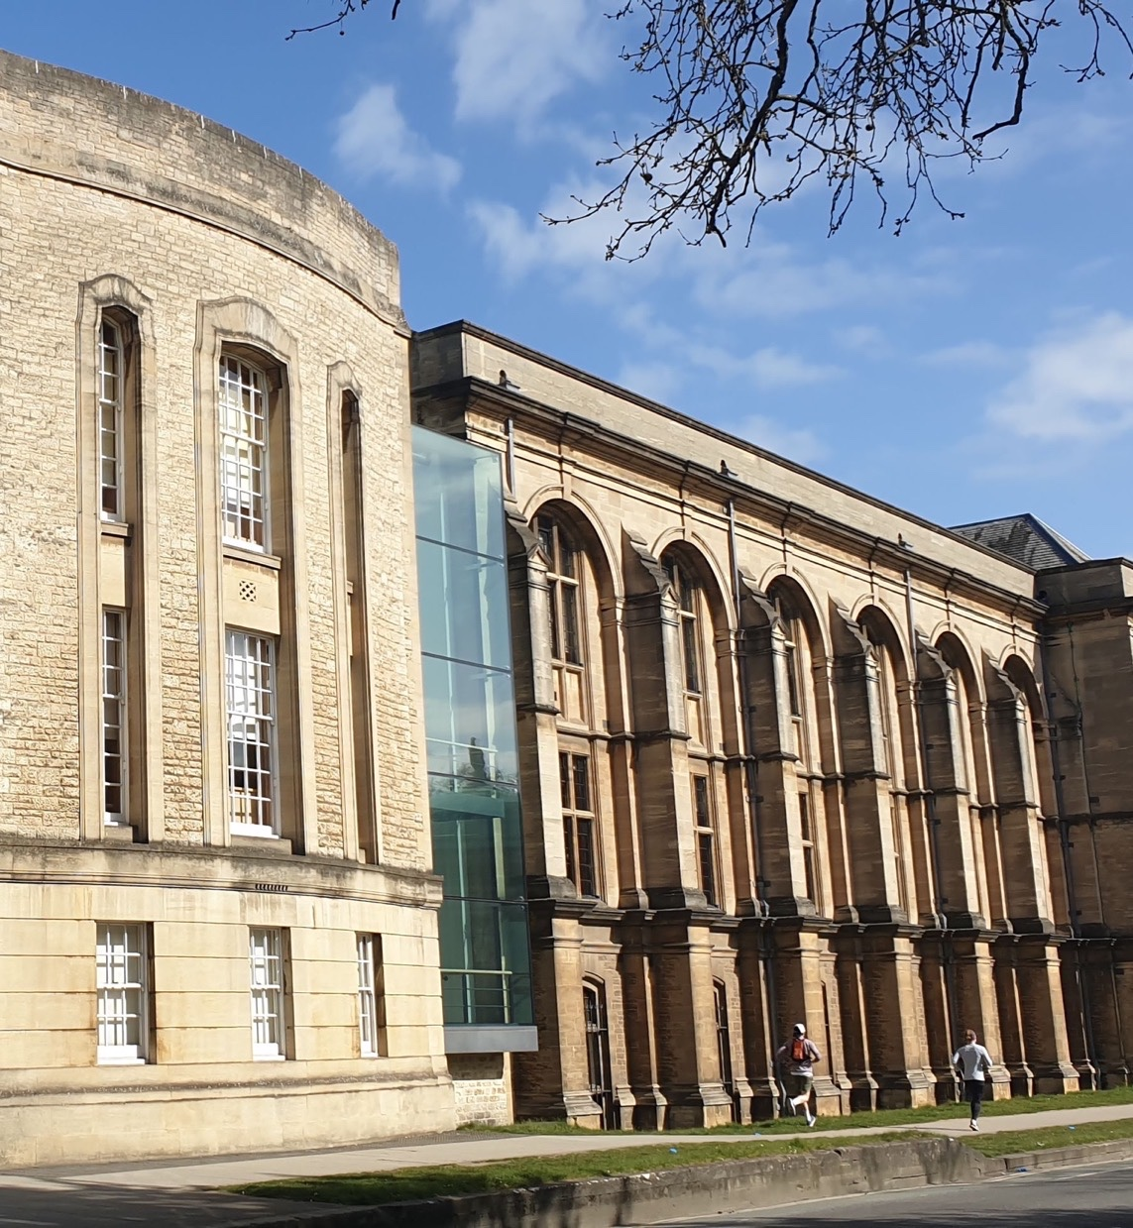




Aims
Wearables, physical activity & sleep:
Important new components for mortality prediction?
Aiden Doherty
Nuffield Department of Population Health
British Heart Foundation Centre for Research Excellence
Sleep and Circadian Neuroscience Institute
Reuben College
To begin acquiring skills, or expand existing capabilities, in machine learning, applied to health
To learn about wearables
To learn how about python and jupyter notebooks
To develop hands-on skills for time-series machine learning with a real-world dataset
Notes:
Aim is to:
1) Introduce how one can infer measurements from wearables
2) Explain why wearables have had little impact on biomedical research (too small, cross-sectional)
3) Introduce UKBB accelerometer data and sense checks on this
4) Introduce longitudinal analysis
5) New directions e.g. VILPA, MV-ILPA, sleep, light 6) Future? Multi-modal, human genetics, less advantaged populations, smartphones 7) Conclusion – a need for more large-scale studies

Slide 2
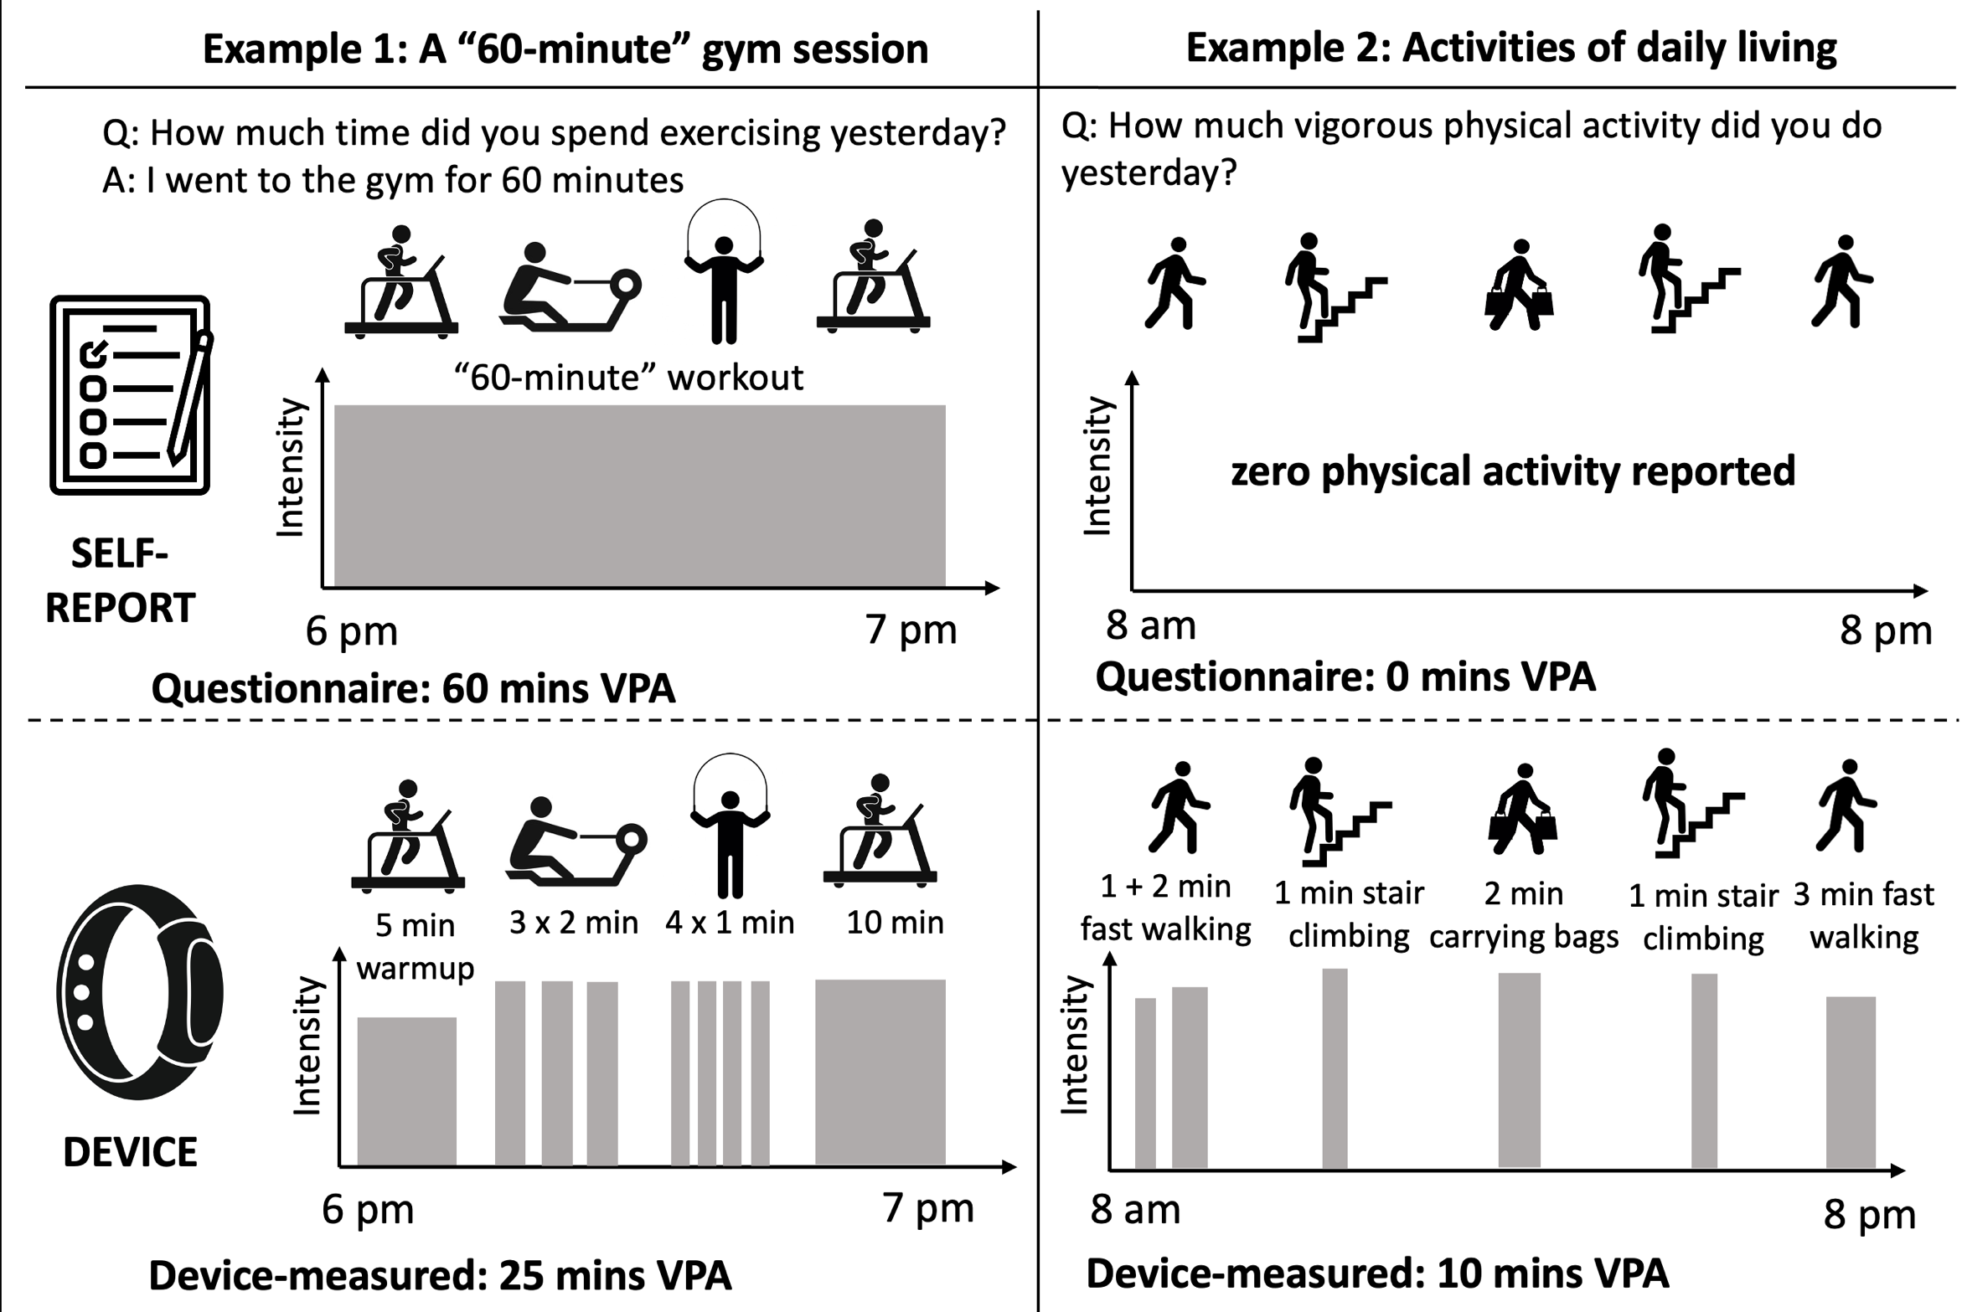
What people report vs what they actually do?
Gill; British Journal of Sports Medicine 2023
Notes:
HSE anecdote about people putting device on their dogs

Slide 3
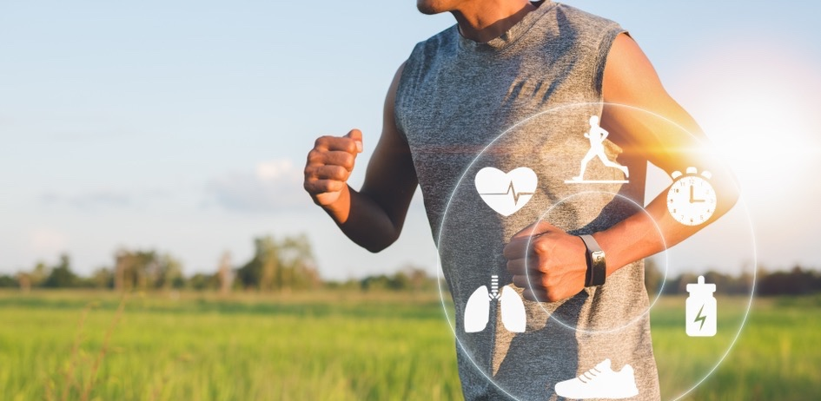
Wearable sensors in health
Collect continuous information on a wide range of important exposures, including:
Physical activity
Heart rhythms
Sleep patterns
Limited impact thus far due to reliance on small scale descriptive or cross-sectional studies
Dixon; Journal of Medical Internet Research 2023; 25:e42449

Slide 4
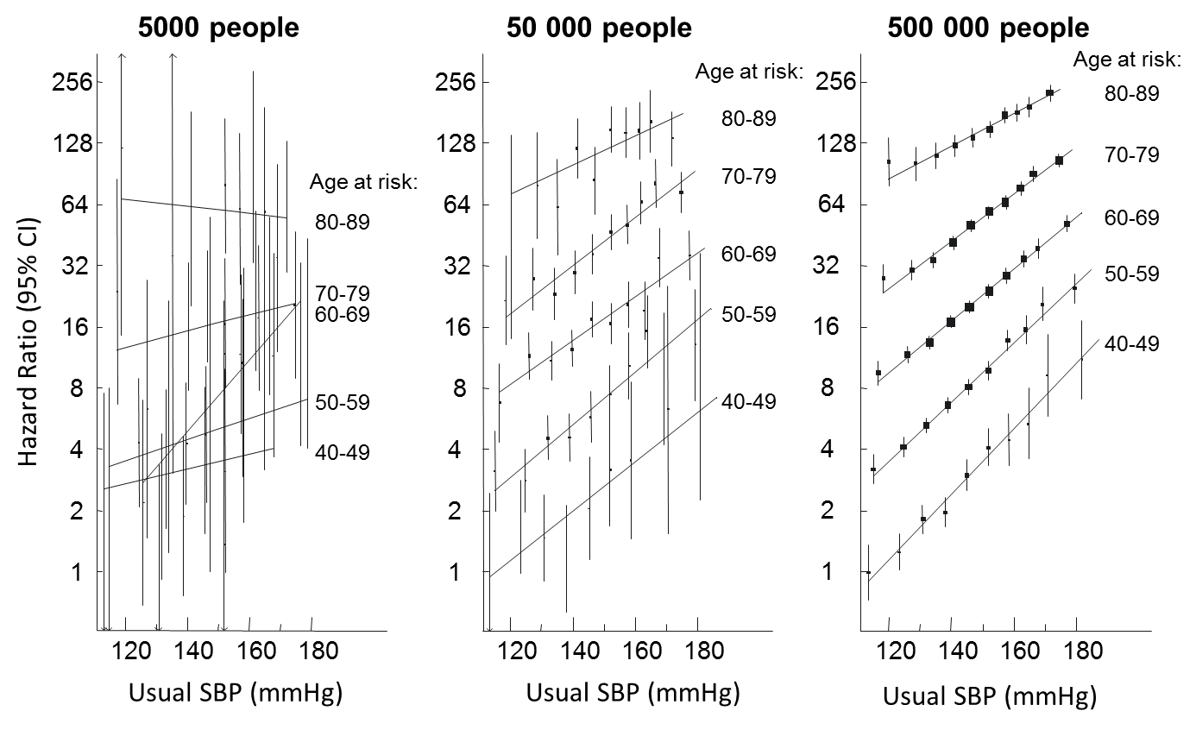
The power of large numbers: Ischaemic heart disease ~ systolic BP
Prof Sarah Lewington on behalf of the Prospective Studies Collaboration
Notes:
Strongest indicators:
- Non-white (0.90)
- Self-reported health status (0.93)

Slide 5

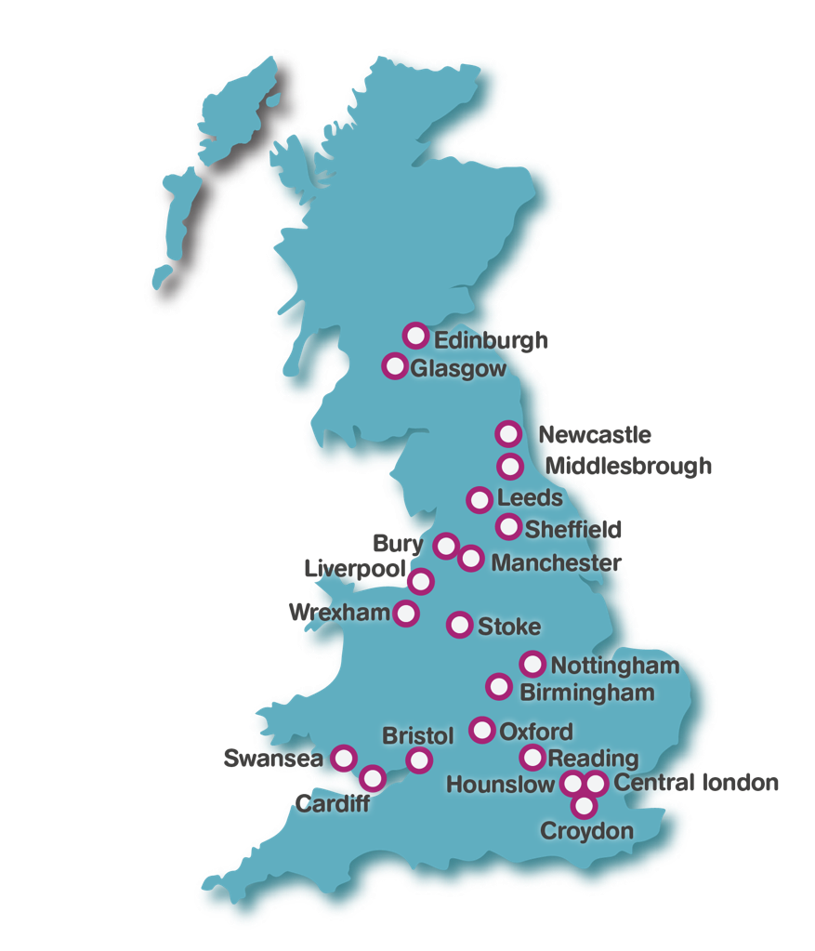
UK Biobank recruitment and baseline assessment
500,000 people aged 40 – 69 in 2006-10 from England (89%), Scotland (7%), and Wales (4%)
22 assessment centres located around the UK to enhance heterogeneity of the cohort
Breadth and depth of data
Lifestyle and environmental exposures
Personal and family medical history
Cognitive function, hearing and vision tests
Physical measures (BP, lung function, body size)
Biological samples (blood, urine, saliva)
Consent to access health-related records and to re-contact participants for further assessments

Slide 6
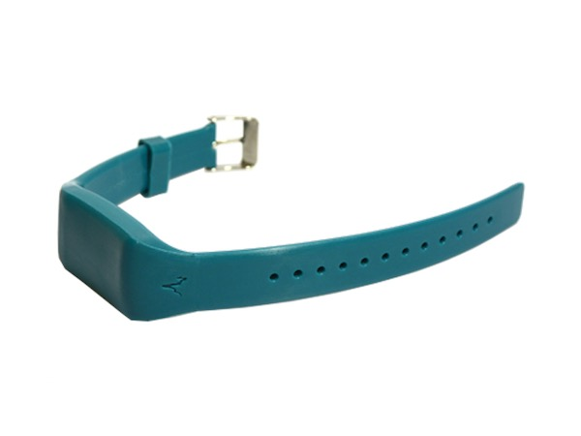
7 day wrist-worn accelerometer data collection in UK Biobank
2013 – 2015
n = 103,712
Consent = 47%
Adherence = 93%
Doherty et al. PLoS One 12, (2017). 12(2):e0169649

Slide 7
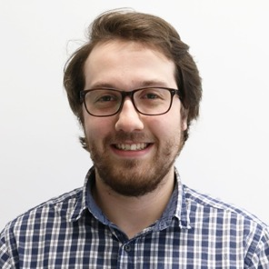
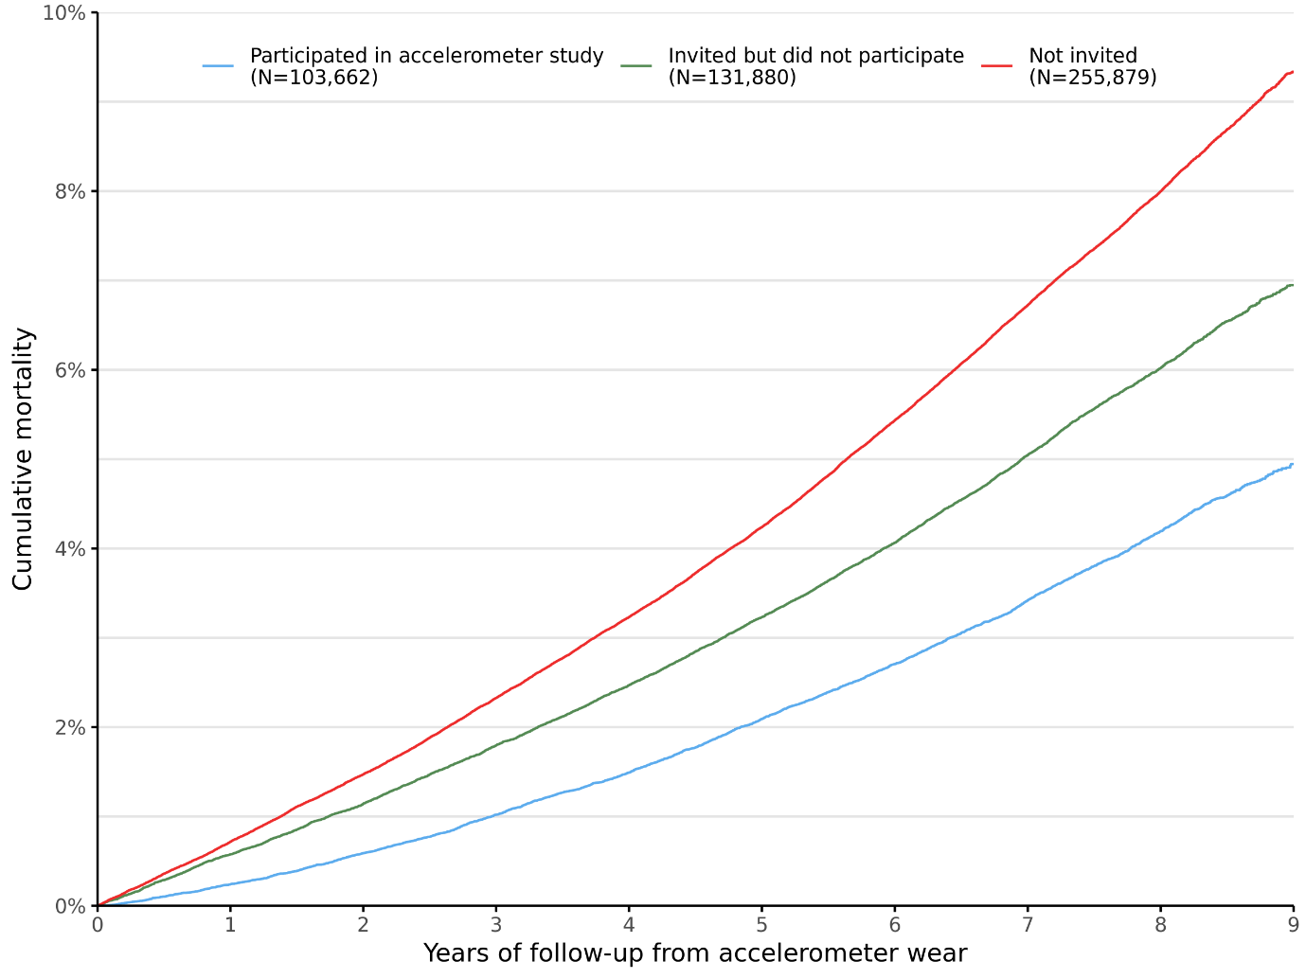
Survivorship by who agreed to wear a device in UK Biobank
Decliner
Responder
*For participants not in the accelerometer study cohort, a hypothetical study date was generated (based on the distribution of existing dates) using bootstrap sampling with replacement.
Harper et al (in preparation)

Slide 8
Does the accelerometer data in UK Biobank look believable?
Doherty et al. PLoS One 12, (2017). 12(2):e0169649

Slide 9
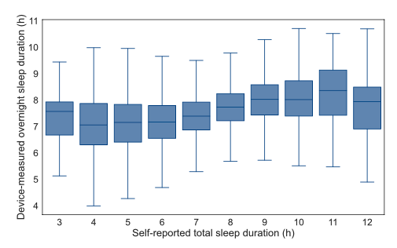
Device versus self-reported sleep duration in ~66k UKB participants
How long do I actually sleep?
How long do I think I sleep?
Yuan et al. npj Digital Medicine 2024; 7(86)

Slide 10
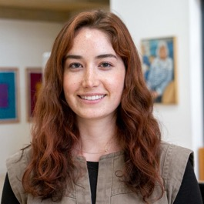
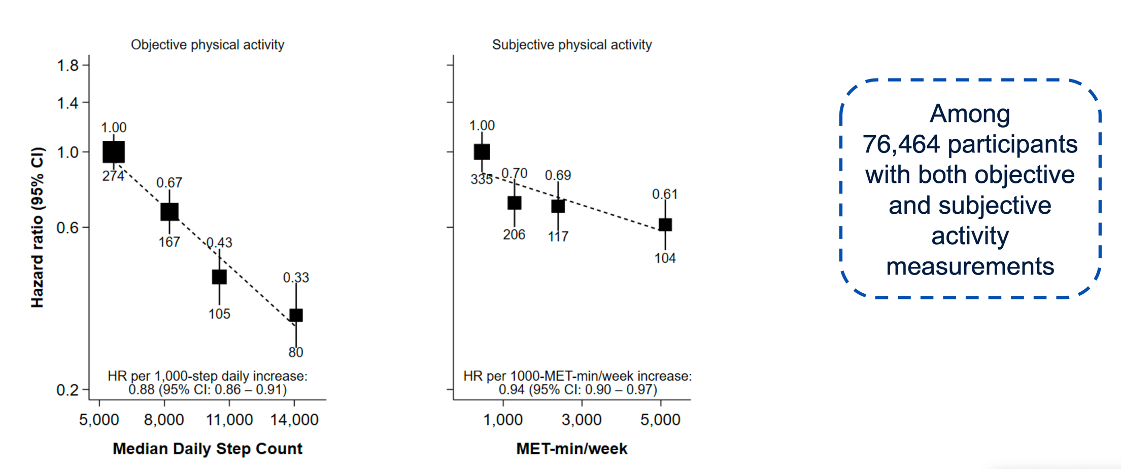
Associations with cardiometabolic disease - device vs. self-report
7.9 years follow-up 762 Non-alcoholic fatty liver disease events
Using age as the time scale and adjusted for sex, ethnicity, Townsend deprivation index, educational attainment, alcohol consumption, smoking status, fruit and vegetable consumption and
Fulda et al. medRxiv 2024.05.17.24307527

Slide 11
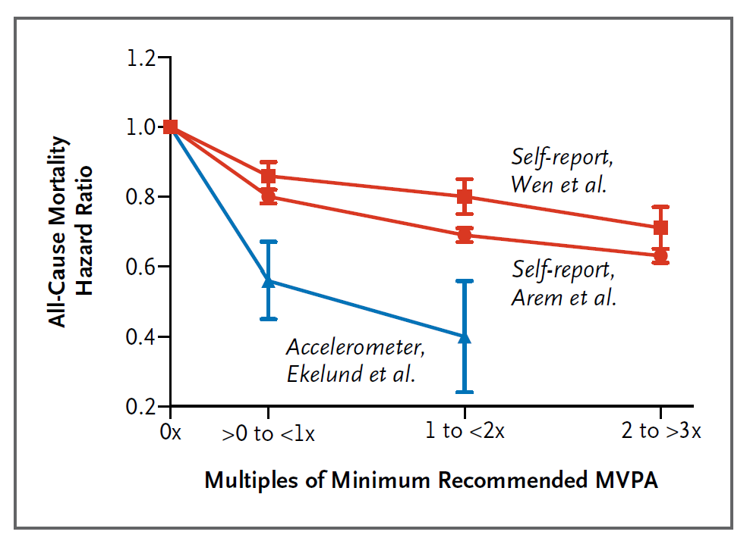
Associations with all-cause mortality - device vs. self-report
Wasfy & Lee, NEJM 2022

Slide 12
Associations with common non-cancer outcomes
6.8 years follow-up
Watts et al
JAMA Net Open 2023;6(2):e2256186.

Slide 13
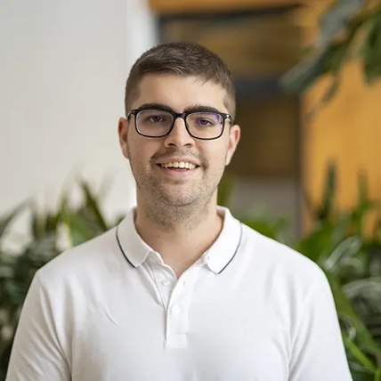
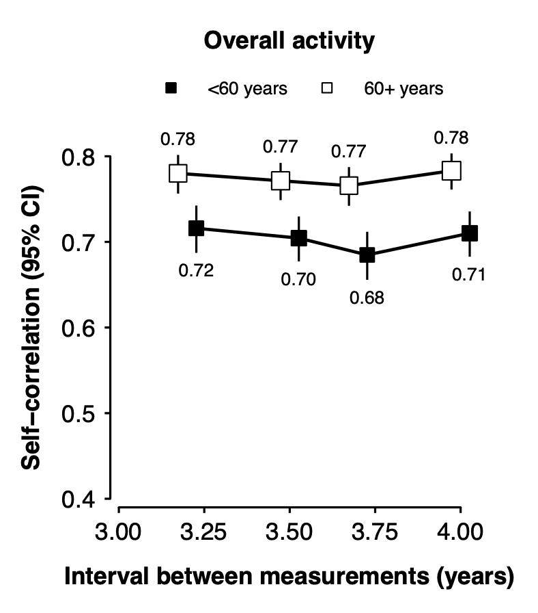
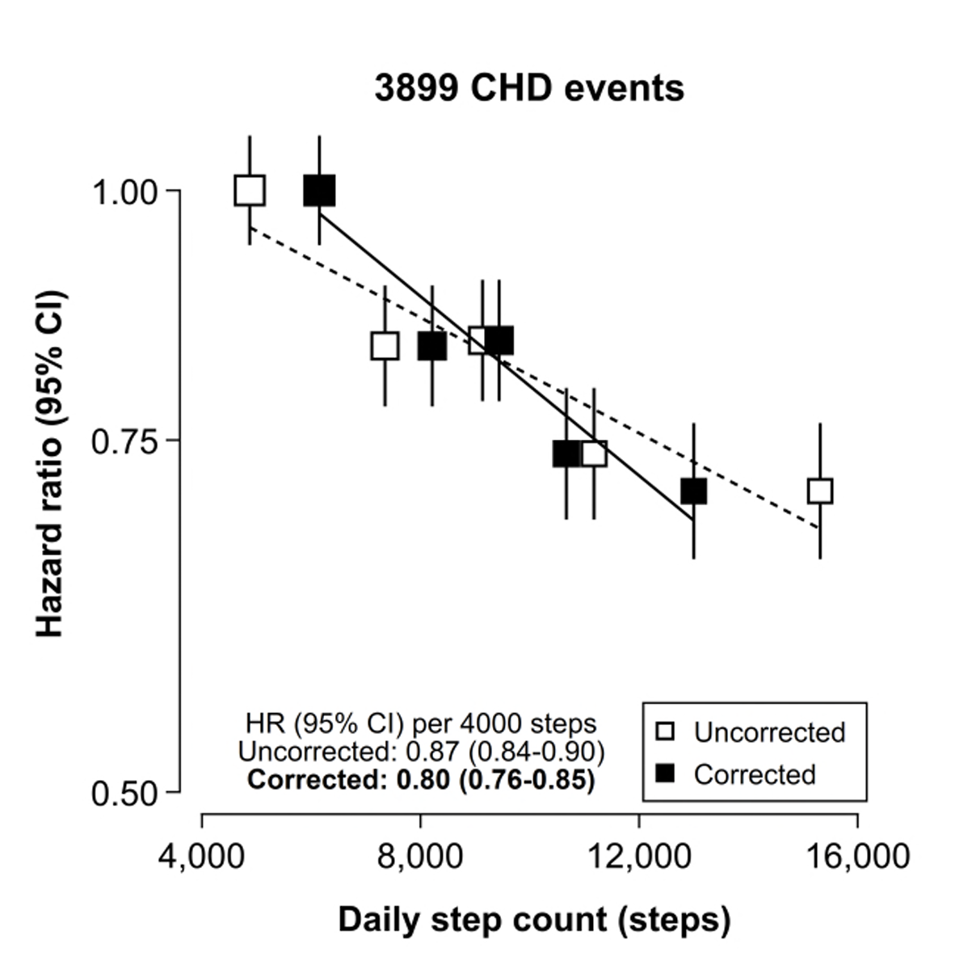
Test – retest reliability - Is a seven-day measurement sufficient?
Zisou et al. medRxiv 2025.01.16.25320679

Slide 14
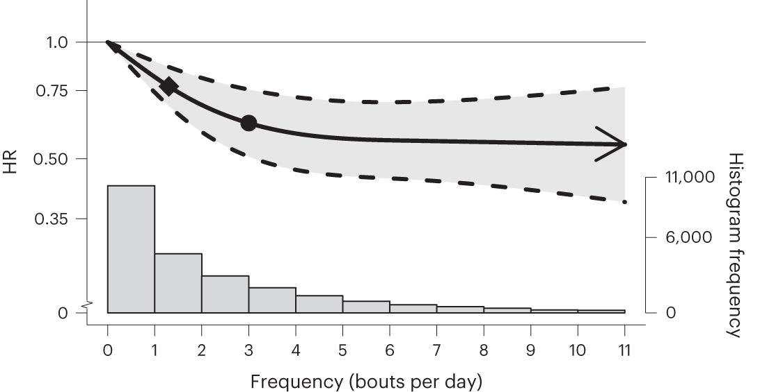
Vigorous Intermittent Lifestyle Physical Activity & all-cause mortality
n = 25,241
852 events
6.9 years follow-up
Stamatakis, et al. Nat Med 28, 2521–2529 (2022)
Ahmadi, et al. Lancet Public Health 2023;8: e800–10

Slide 15
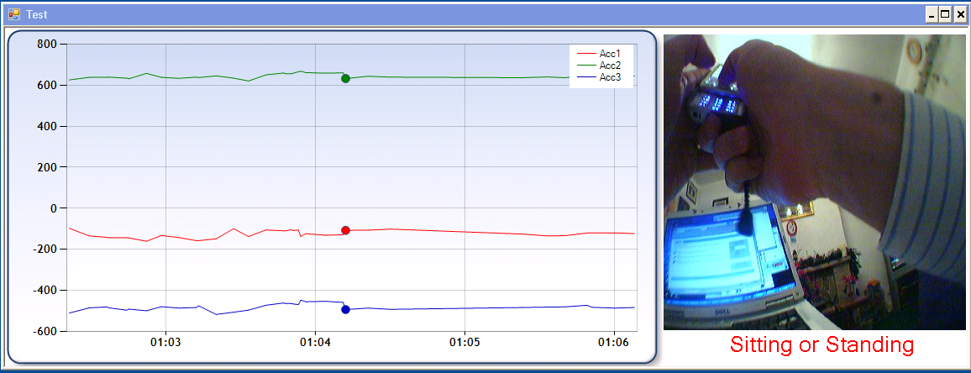
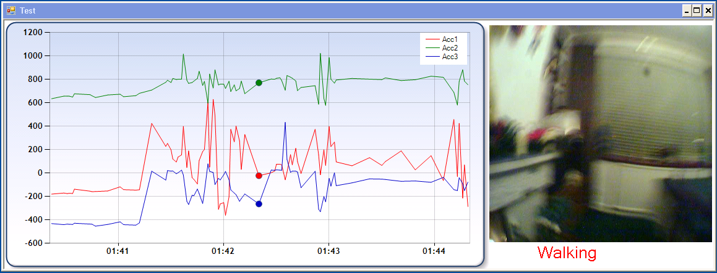
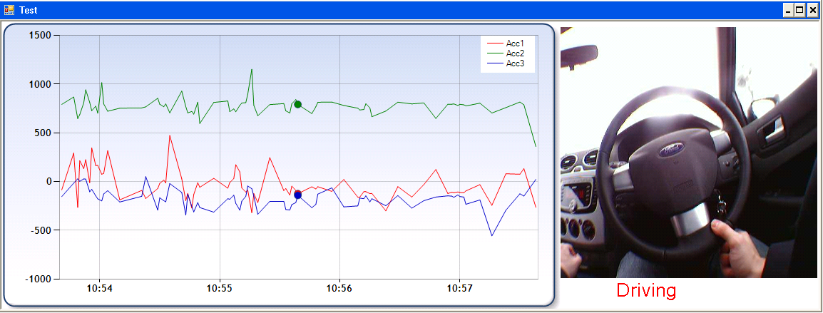
Inference of activity & sleep behaviours from wearables
Take Mediamill SVM slides showing the nuts ‘n bolts of this… highlight groundtruth construction, etc.
Willetts et al Scientific Reports 2018

Slide 16
Machine learning of behaviours from acc data
Free living groundtruth via wearable cameras
150 people – activity monitors + cameras
Notes:
Solution: Scalable computational & machine learning methods, tested in naturalistic free-living environments, to inform healthcare analysis in very large datasets.
Machine learning: We extract time and frequency domain features from raw acceleration data, and then train a random forest classifier to predict whether a person is walking, sitting, running, sleeping, etc. We then perform time-smoothing over these predictions by training hidden markov models.

Slide 17
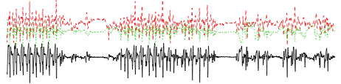
How we might have approached behaviour inference before
Final behavior predictions
walk
walk
walk
. . .
Time-smoothing
Models long-term patterns of behavior
walk
bike
walk
. . .
30-sec level classifier
Models specific patterns of movement
0.002
0.254
0.304
0.342
0.342
0.454
0.134
0.098
0.142
0.444
0.872
0.493
. . .
Feature Extraction
30 seconds of raw tri-axial data
125-dimensional feature vector
Basic statistical descriptors
Correlation between axes & autocorrelation
Angular features
Frequency domain features
Per axis features
Raw sensor data
Willetts et al Scientific Reports 2018

Slide 18
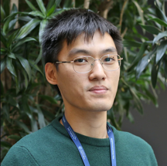
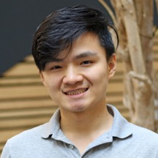
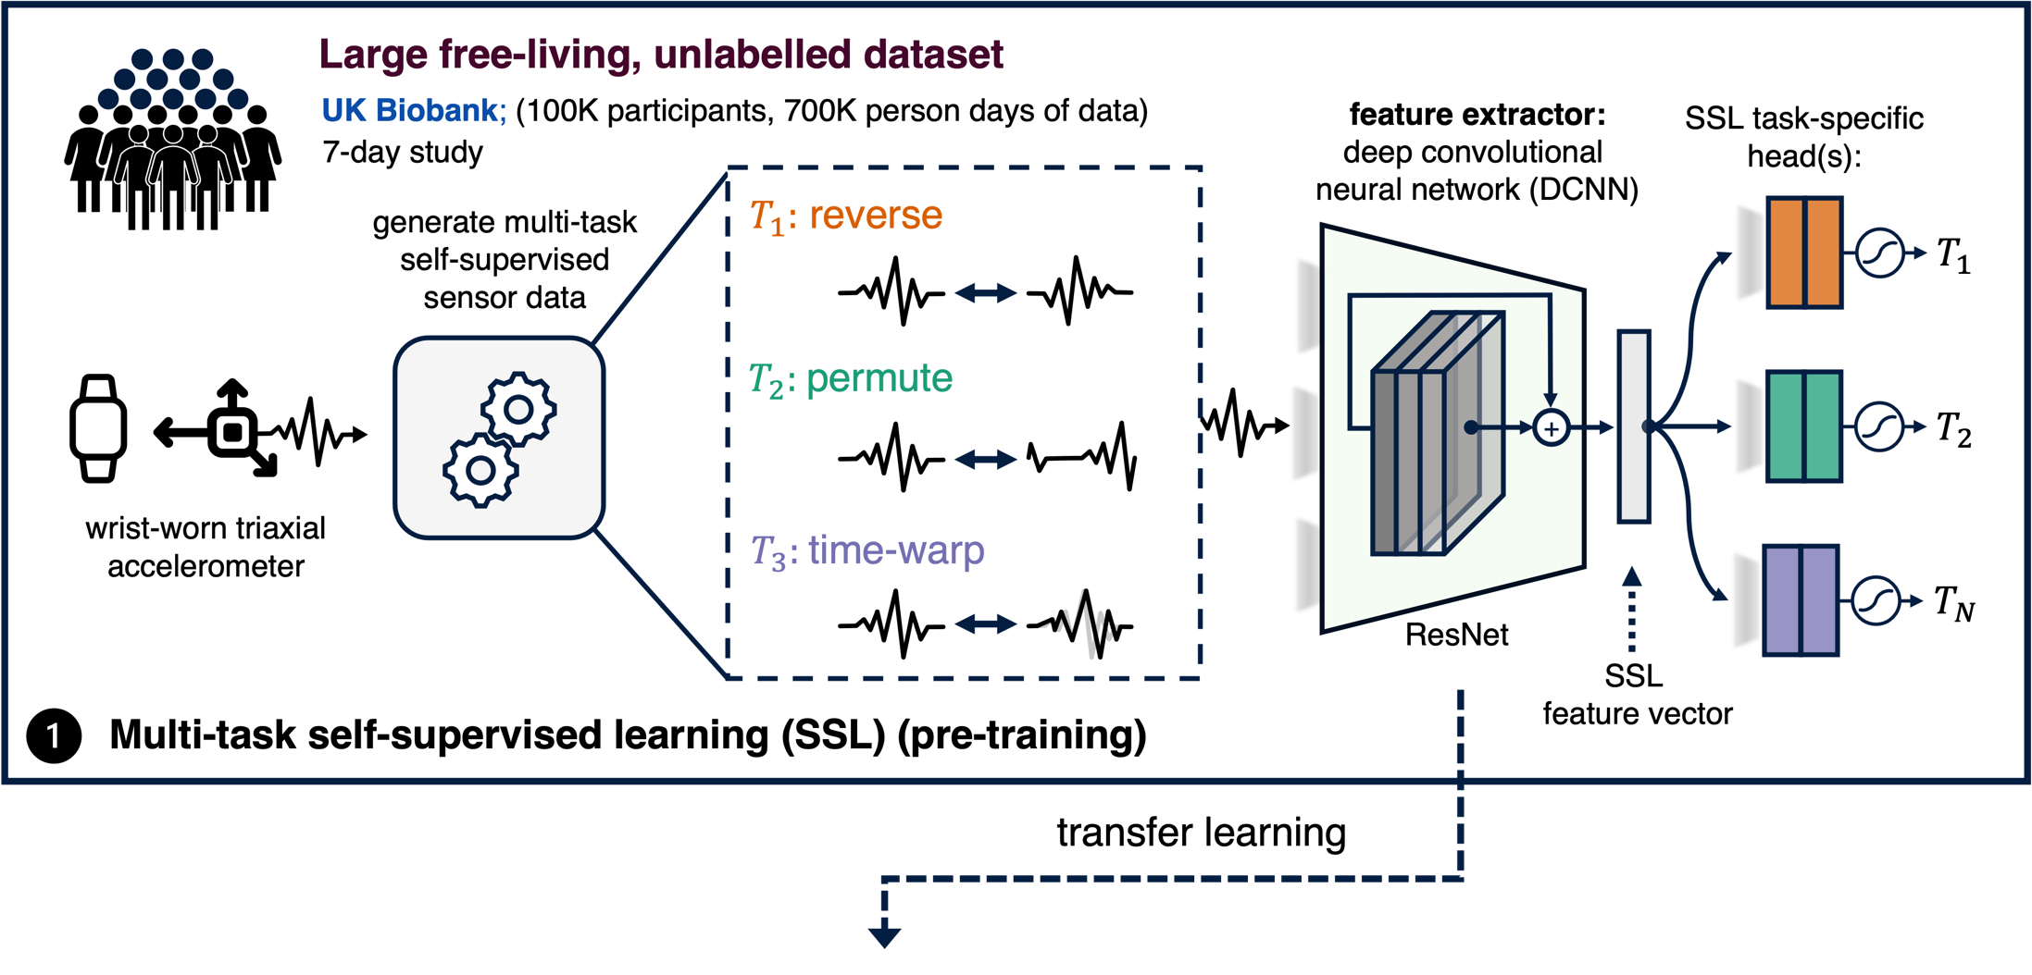
Self-supervised feature learning
Yuan et al. npj Digital Medicine 2024: 7(91)

Slide 19
Self-supervision generalises across devices, tasks, and populations
Dataset | Sample Size | Traditional Neural Network | Self-supervised Learning | Improvement
Capture-24 | 152 | 0.703 ± .092 | 0.737 ± .087 | 5%
Rowlands | 55 | 0.810 ± .098 | 0.874 ± .073 | 8%
WISDM | 46 | 0.685 ± .124 | 0.809 ± .126 | 18%
MJFF-LR | 28 | 0.347 ± .128 | 0.817 ± .080 | 135%
REALWORLD | 14 | 0.638 ± .079 | 0.739 ± .086 | 16%
Yuan et al. npj Digital Medicine 2024: 7(91)

Slide 20
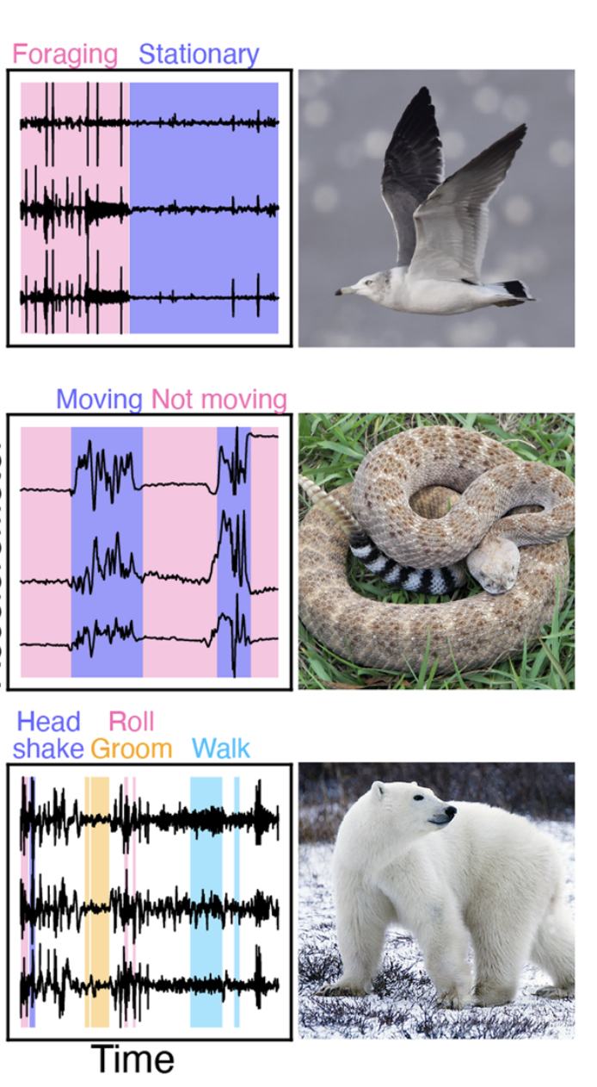
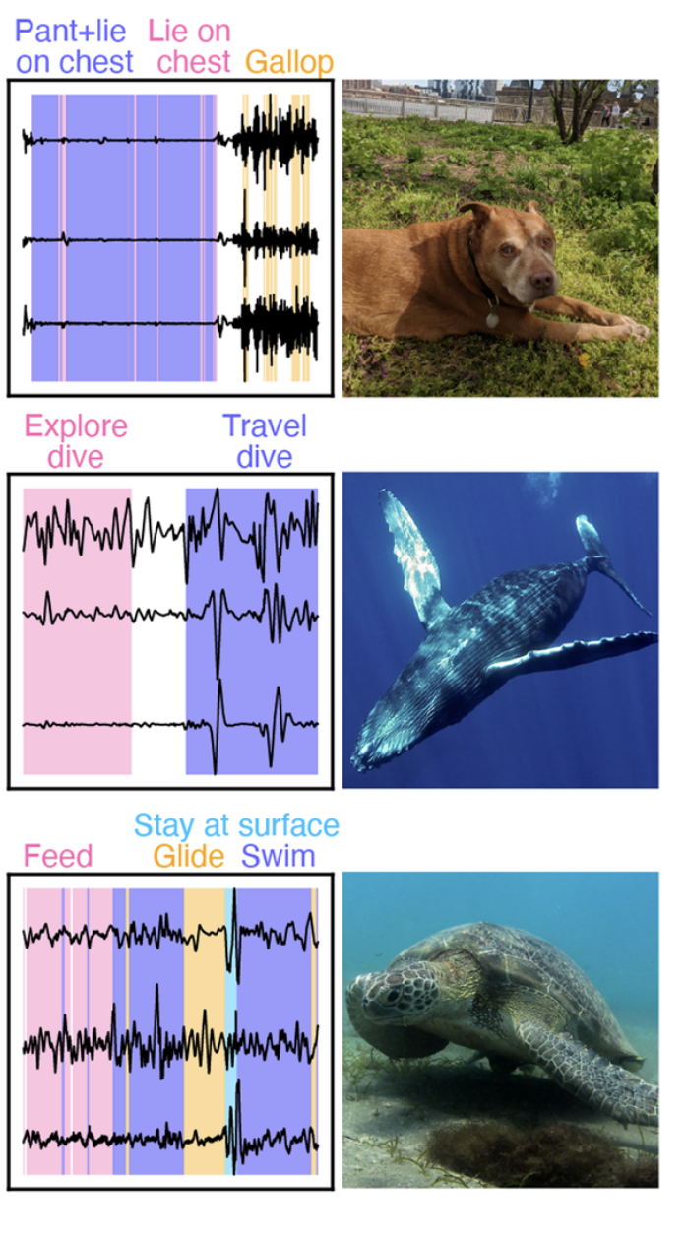
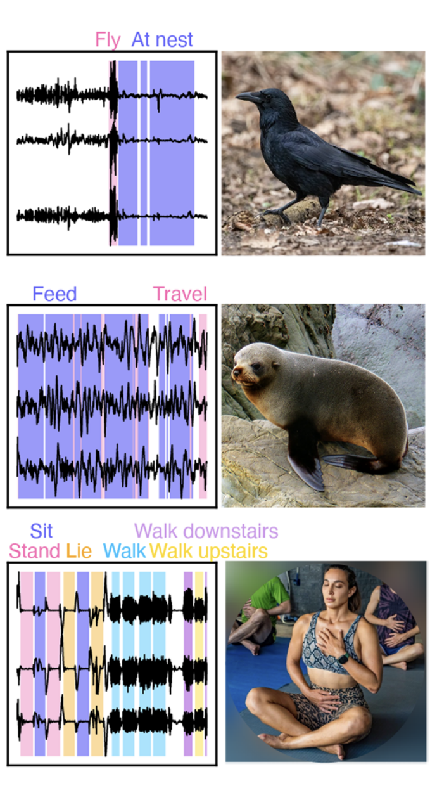
Self-supervision even generalises across species
Self-supervision F1 score: 0.78 Without self-supervision : 0.50
0.62 0.36
0.82 0.31
0.99 0.79
0.90 0.48
0.69 0.71
0.66 0.34
0.68 0.23
0.70 0.50
0.98 0.72
Hoffman et al. Movement Ecology 2024: 12(78)
Notes:
Earth Species Project, Berkely
Datasets in BEBE, with a photo of a representative individual and a 5minute clip of annotated triaxial accelerometer (TIA) data for each. Each accelerometer channel is minmax scaled for visualization. Top row: blacktailed gull (Larus crassirostris) [35], domestic dog (Canis familiaris) [29, 36], carrion crow (Corvus corone) [37] (see Methods). Middle row: western diamondback rattlesnake (Crotalus atrox) [17], humpback whale (Megaptera novaeangliae) [38], New Zealand fur seal (Arctocephalus forsteri) [39]. Bottom row: polar bear (Ursus maritimus) [22, 40], sea turtle (Chelonia mydas) [18], human (Homo sapiens) [41]. Gaps indicate that the behavior annotation is Unknown
None of the ablations we tested approached the performance of harnet, indicating that the pre-training step, and not another design choice, was responsible for its high performance. Te alternative setup for the pre-trained model, harnet unfrozen, achieved lower scores than harnet on eight of nine datasets (average F1 drop:.263). After reducing the amount of training data, the pretrained harnet model dropped in F1 performance by 0.056 on average, as compared with a drop of 0.112 by CRNN and 0.069 by RF (Nathan) harnet achieved the top F1 score on all nine datasets in the reduced data setting

Slide 21
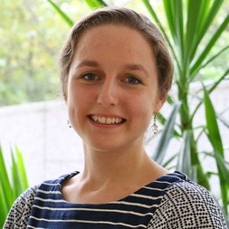
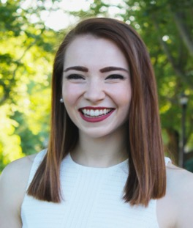
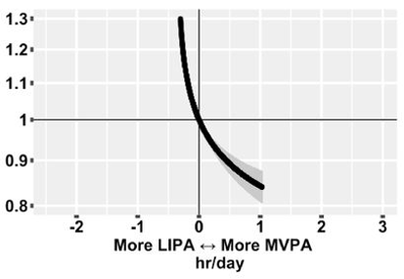
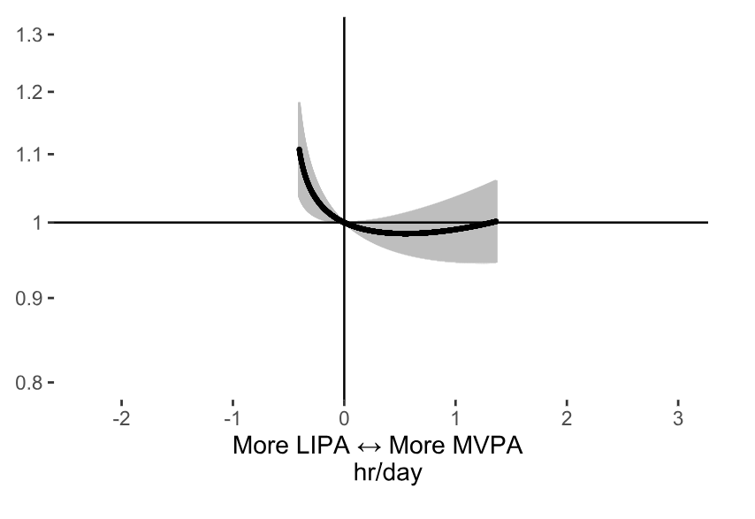
Substitution of time between behaviours
Hazard ratios for incident disease associated with balance between physical behaviours in >86,000 UK Biobank participants
Cardiovascular disease
Cancer
Estimated hazard ratio
7.0 years follow-up
(585k person years)
4,673 CVD events
6.1 years follow-up
(505k person years)
2,669 cancer events
Walmsley et al British Journal of Sports Medicine 2021 Shreves et al. medRxiv 2023.12.04.23299386

Slide 22

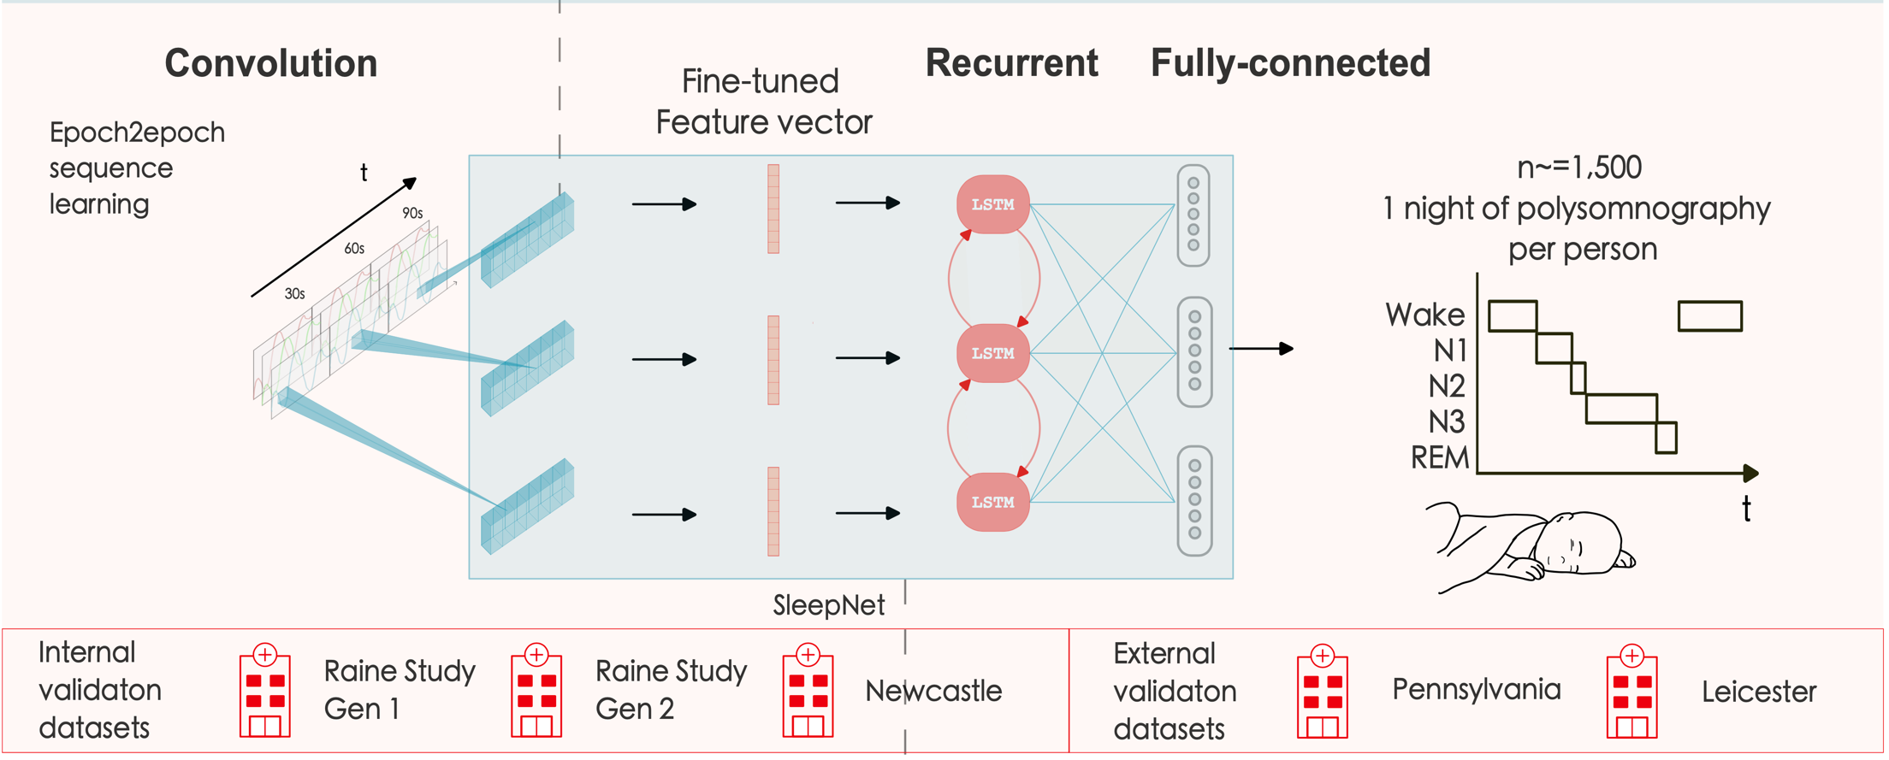
Sleep measurement & validation versus polysomnography
Yuan et al. npj Digital Medicine 2024; 7(86)

Slide 23
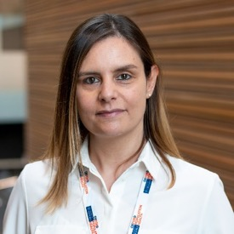
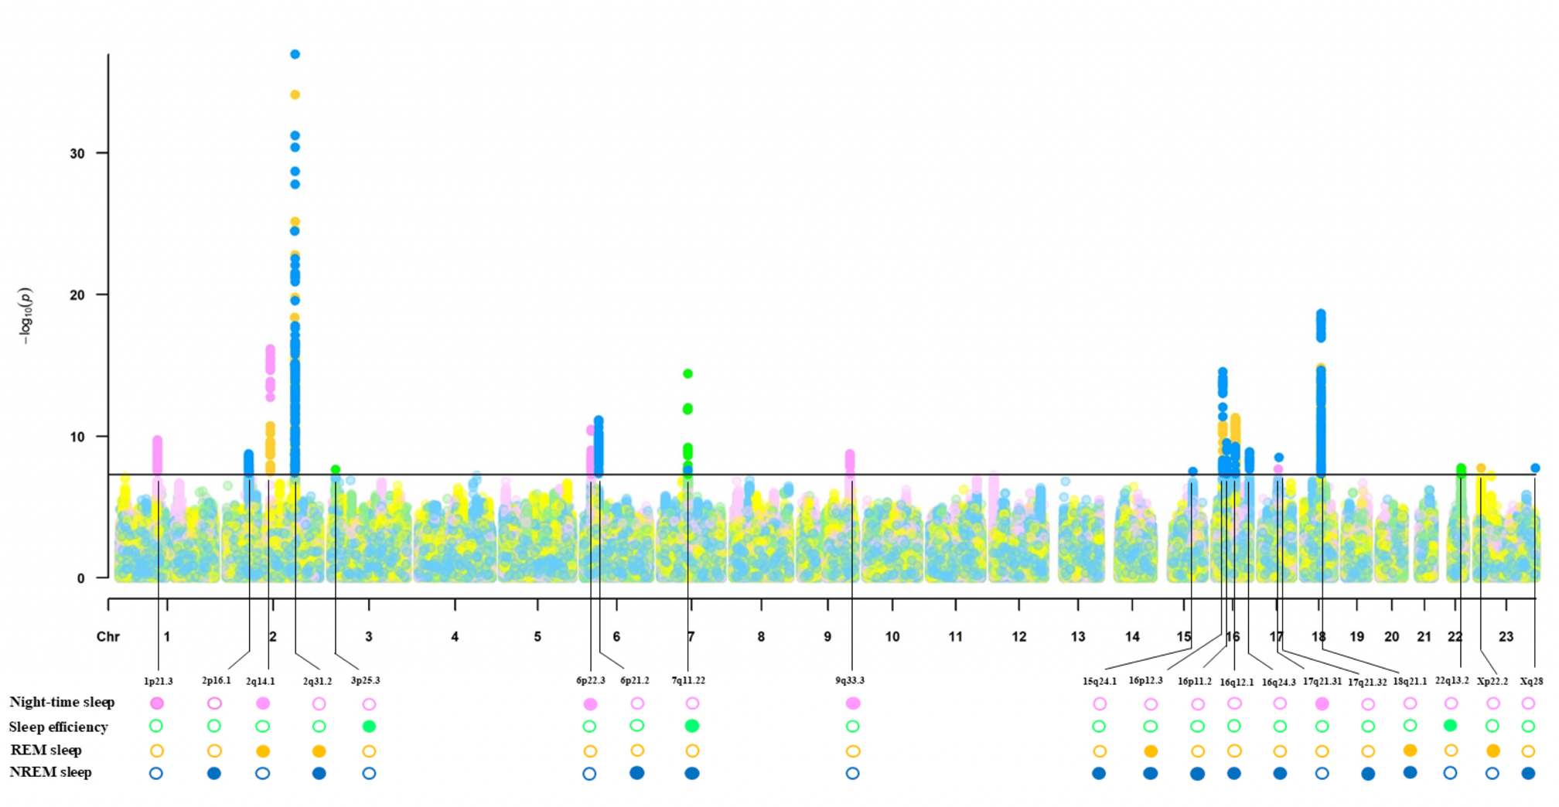
Genetic architecture of sleep architecture
Portas et al. (in preparation)

Slide 24
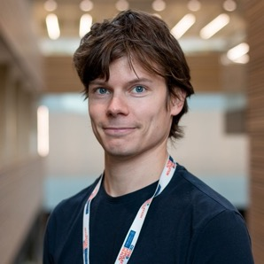
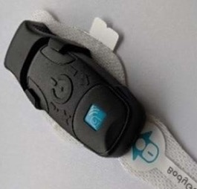
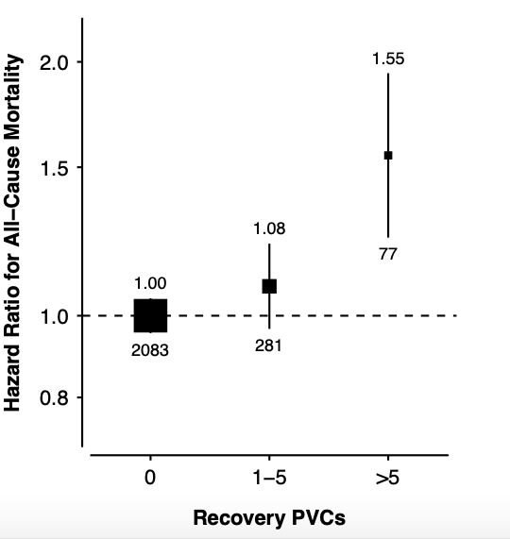
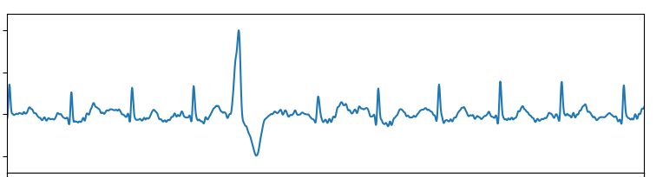
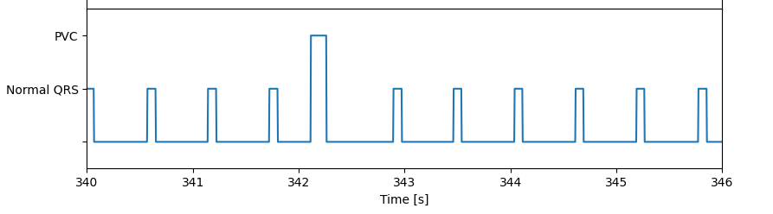
Where next? New measurements in UK Biobank
Chest worn cardiac monitor
2016 –
n ≈ 30,000
Consent ≈ 60%
Wear ≈ 12 / 14 days
ECG lead I
Detection of premature ventricular contractions (PVC)
using 1D convolutional network
11.5 years follow-up
2,441 mortality events
PVC
Normal
N/A
Van Duijvenboden et al. Circulation 2023
Notes:
Old numbers: 14,145 participants (7,785 iRhythm, 6,360 Preventice).

Slide 25
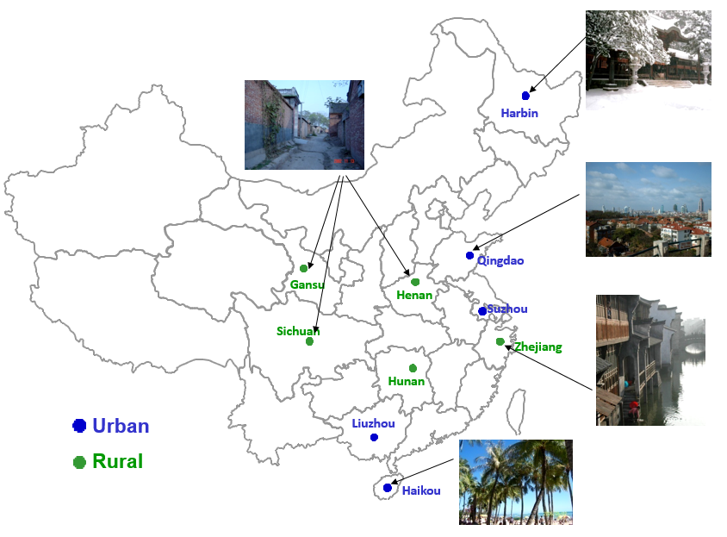
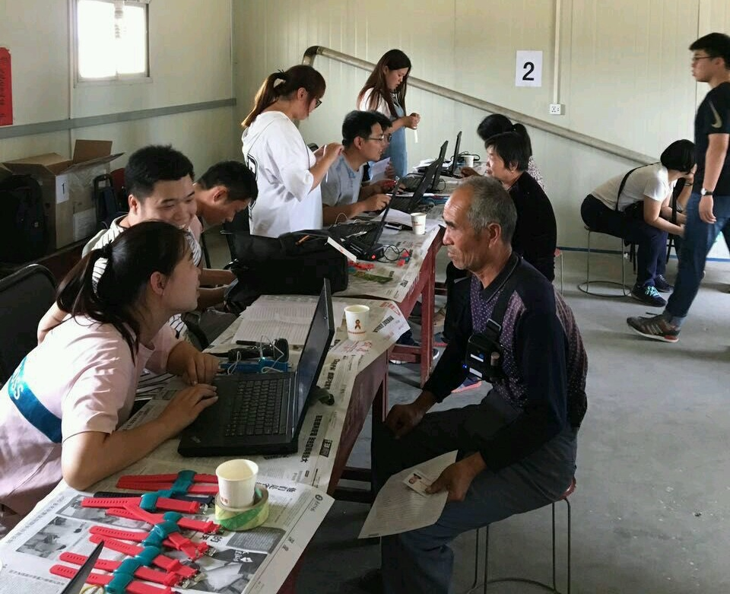
Where next? New populations – China Kadoorie Biobank
UKB 2013 – 2015
n = 103,712
Consent = 47%
Adherence = 93%
CKB 2020 - 2021
n = 20,375
Consent = 89%
Adherence = 93%
Doherty et al. PLoS One 12, (2017). 12(2):e0169649
Yu et al International Journal of Behavioural Nutrition & Physical Activity 2023 20:138

Slide 26
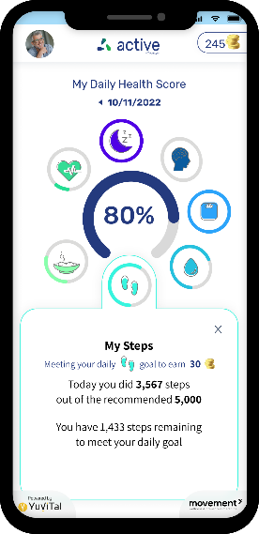
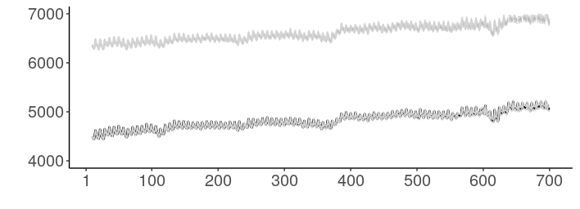
Smartphones are heterogeneous but exciting e.g. Clalit Cohort, Israel
n = 622,584 consent = ~26 %
Men
Steps per day
Women
Day of measurement
Berliner et al. (under review)

Slide 27
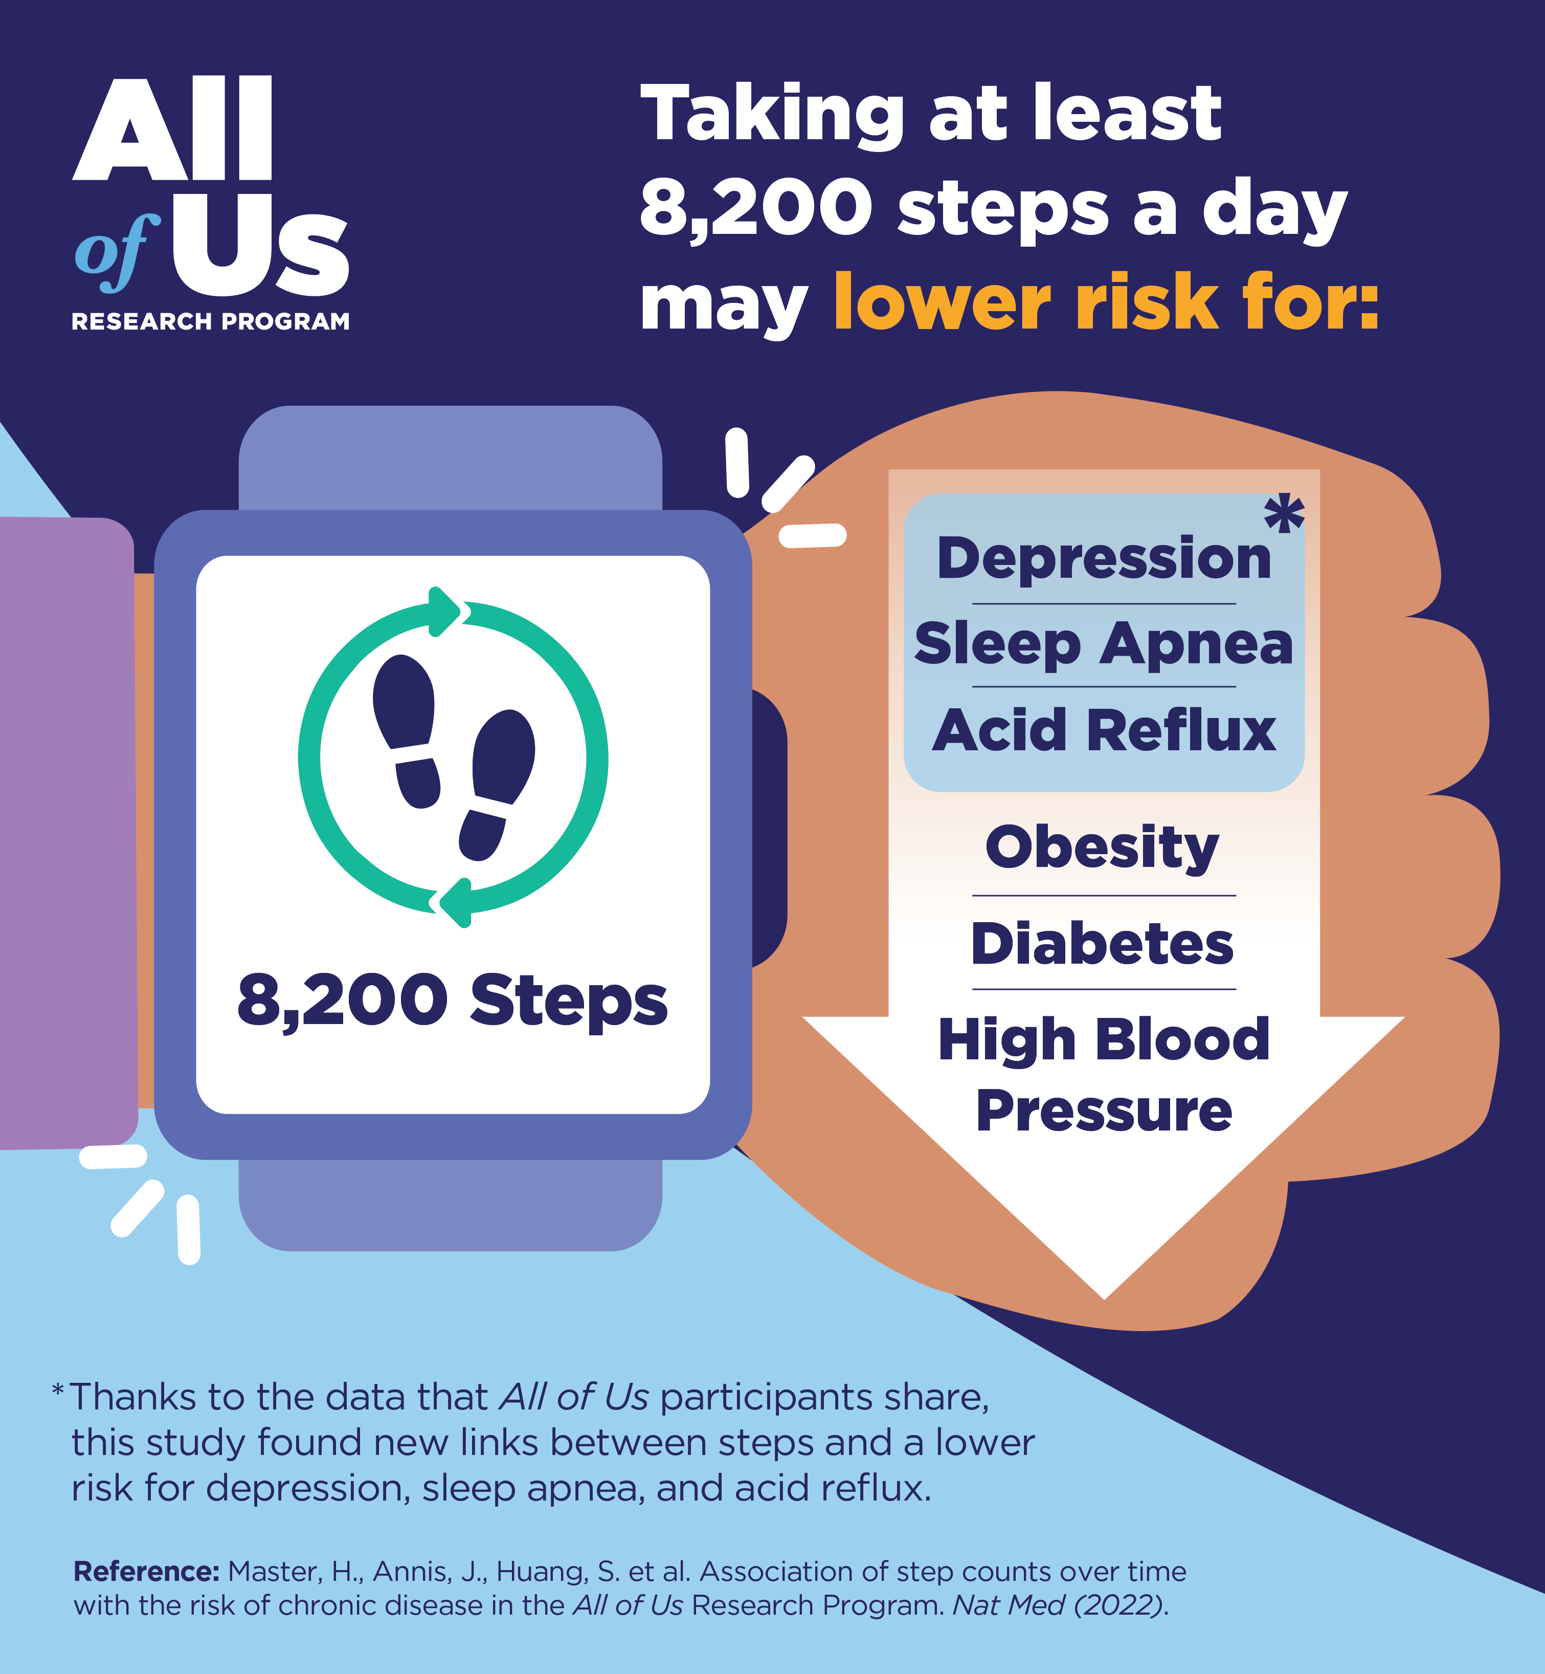
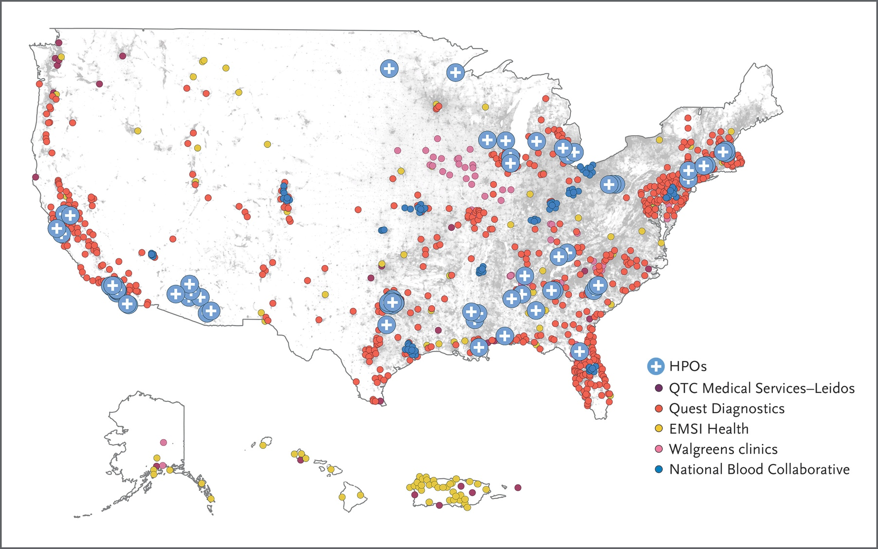
Commercial wearables – All of Us Cohort, USA
n ≈ 50,000
Fitbit worn for 4 years
Master et al Nature Medicine 2022;28:2301-2308

Slide 28
Where next? UK Biobank cohort wide repeat assessment
Cohort is optimal age for assessing age-related health
Average age now 70 (range mid 50s-mid 80s)
Opportunity to include additional assessments (and biological samples):
Behaviour relevant to early detection of neurodegenerative disease (e.g. memory, speech, movement)
Measures of ageing and frailty via:
Assessment centre measures
Remote measures (e.g. wearables, nearables, apps, online questionnaires) to assess physiology and behaviour

Slide 29
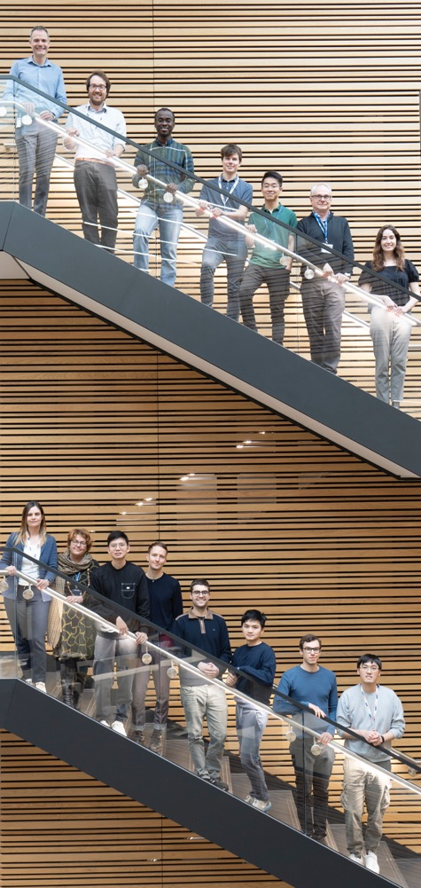
https://www.bdi.ox.ac.uk/research/wearables-group
Integrating wearables across large-scale studies will transform our ability to answer important new questions:
What is the impact of transitions in physical activity and sleep on future disease risk?
Are movement behaviours causally associated with future morbidity and mortality?
What is the association between new exposures and future health?
Which randomised interventions improve activity and sleep?

